Slide 1
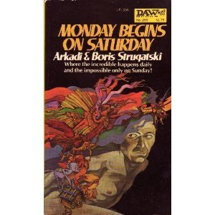
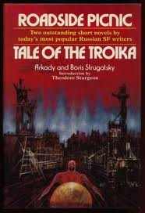

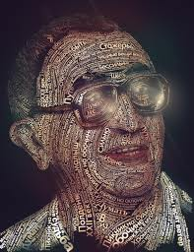
RIP Boris Strugatski Science Fiction will never be the same

Slide 2
Implicit Sentiment Mining (do you tweet like Hamas?)
Maksim Tsvetovat
Jacqueline Kazil
Alexander Kouznetsov

Slide 3
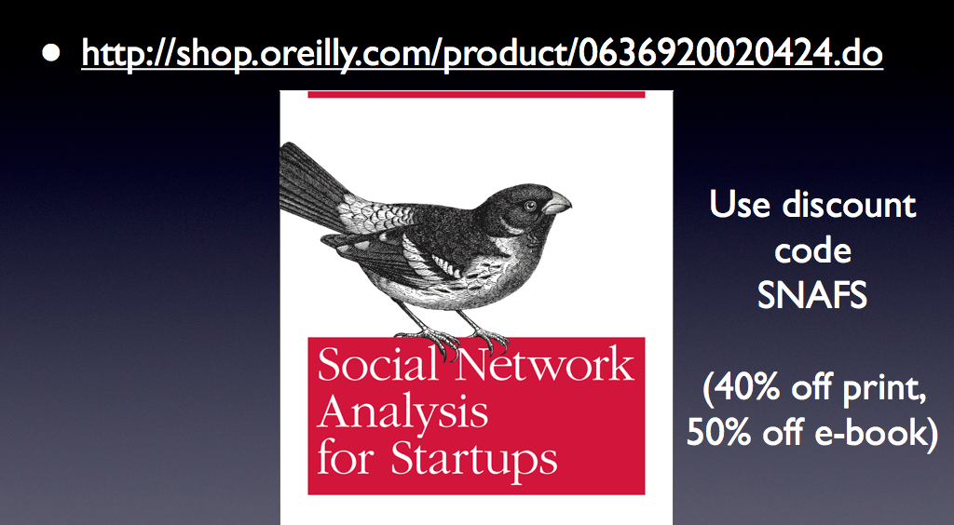
My book

Slide 4
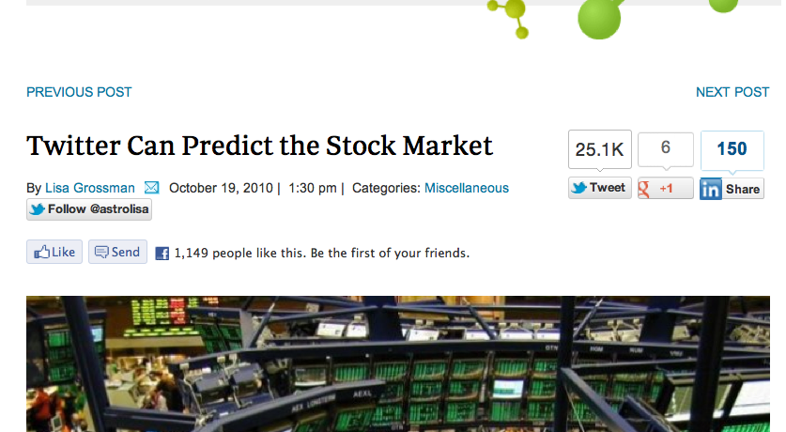
Twitter predicts stock market

Slide 5
Sentiment Mining, old-schoool
Start with a corpus of words that have sentiment orientation (bad/good):
“awesome” : +1
“horrible”: -1
“donut” : 0 (neutral)
Compute sentiment of a text by averaging all words in text

Slide 6
…however…
This doesn’t quite work (not reliably, at least).
Human emotions are actually quite complex
….. Anyone surprised?

Slide 7
We do things like this:
“This restaurant would deserve highest praise if you were a cockroach” (a real Yelp review ;-)

Slide 8
We do things like this:
“This is only a flesh wound!”

Slide 9
We do things like this:
“This concert was f**ing awesome!”

Slide 10
We do things like this:
“My car just got rear-ended! F**ing awesome!”

Slide 11
We do things like this:
“A rape is a gift from God” (he lost! Good ;-)

Slide 12
To sum up…
Ambiguity is rampant
Context matters
Homonyms are everywhere
Neutral words become charged as discourse changes, charged words lose their meaning

Slide 13
More Sentiment Analysis
We can parse text using POS (parts-of-speech) identification
This helps with homonyms and some ambiguity

Slide 14
More Sentiment Analysis
Create rules with amplifier words and inverter words:
“This concert (np) was (v) f**ing (AMP) awesome (+1) = +2
“But the opening act (np) was (v) not (INV) great (+1) = -1
“My car (np) got (v) rear-ended (v)! F**ing (AMP) awesome (+1) = +2??

Slide 15
To do this properly…
Valence (good vs. bad)
Relevance (me vs. others)
Immediacy (now/later)
Certainty (definitely/maybe)
…. And about 9 more less-significant dimensions
Samsonovich A., Ascoli G.: Cognitive map dimensions of the human value system extracted from the natural language. In Goertzel B. (Ed.): Advances in Artificial General Intelligence (Proc. 2006 AGIRI Workshop), IOS Press, pp. 111-124 (2007).

Slide 16
This is hard
But worth it? Michelle de Haaff (2010), Sentiment Analysis, Hard But Worth It!, CustomerThink

Slide 17
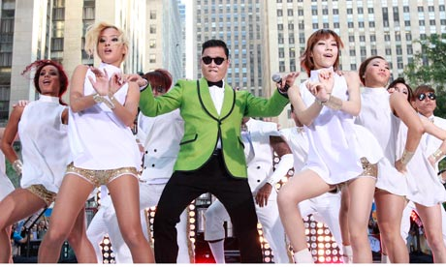
Sentiment, Gangnam Style!

Slide 18
Hypothesis
Support for a political candidate, party, brand, country, etc. can be detected by observing indirect indicators of sentiment in text

Slide 19
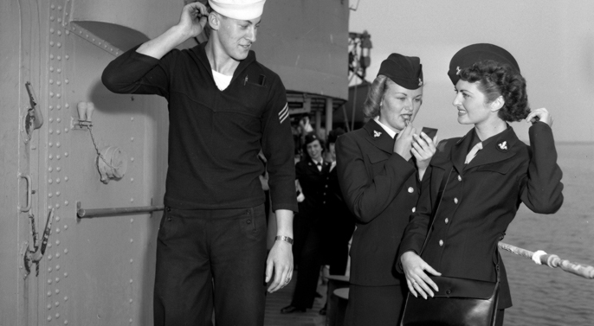
Mirroring – unconscious copying of words or body language
Fay, W. H.; Coleman, R. O. (1977). "A human sound transducer/reproducer: Temporal capabilities of a profoundly echolalic child". Brain and language 4 (3): 396–402

Slide 20
Marker words
All speakers have some words and expressions in common (e.g. conservative, liberal, party designation, etc)
However, everyone has a set of trademark words and expressions that make him unique.

Slide 21
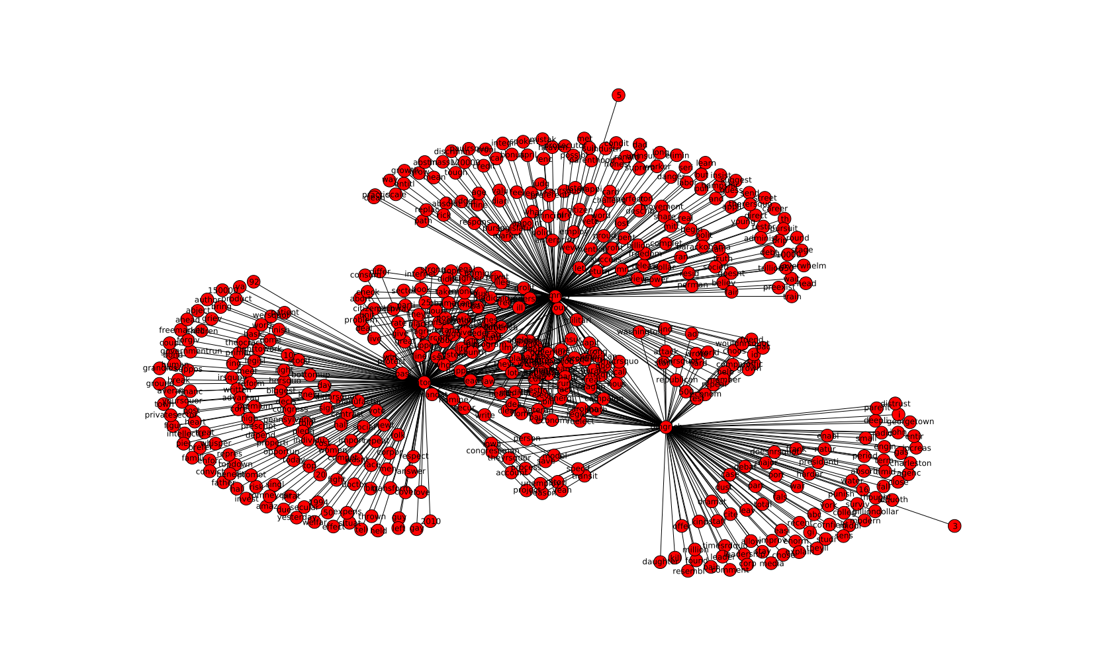
GOP Presidential Candidates

Slide 22
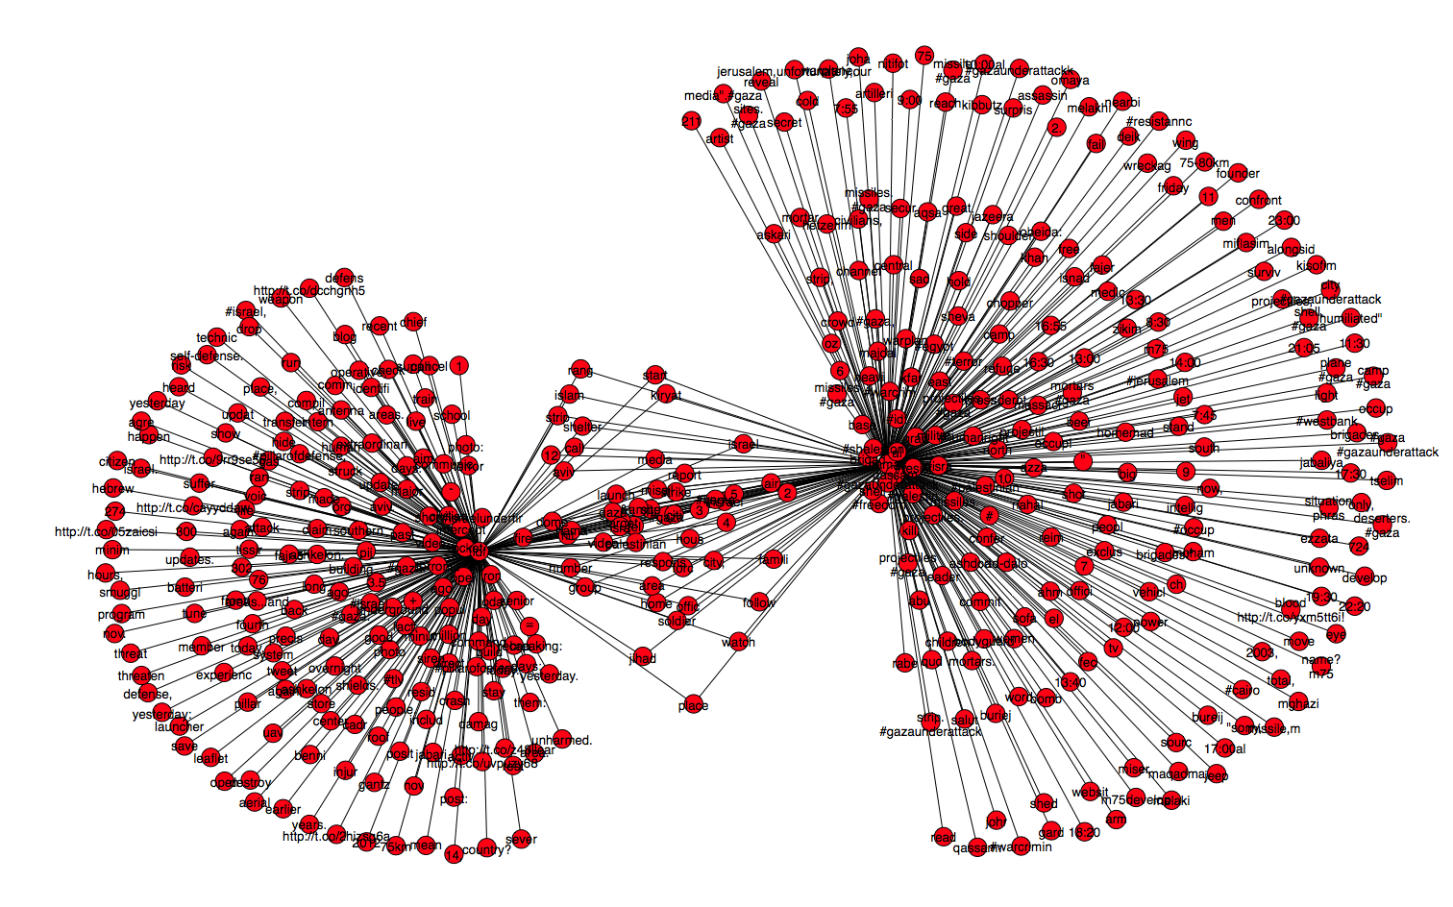
Israel vs. Hamas on Twitter

Slide 23
Observing Mirroring
We detect marker words and expressions in social media speech and compute sentiment by observing and counting mirrored phrases

Slide 24
The research question
Is media biased towards Israel or Hamas in the current conflict?
What is the slant of various media sources?

Slide 25
Data harvest
Get Twitter feeds for:
@IDFSpokesperson
@AlQuassam
Twitter feeds for CNN, BBC, CNBC, NPR, Al-Jazeera, FOX News – all filtered to only include articles on Israel and Gaza
(more text == more reliable results)

Slide 26
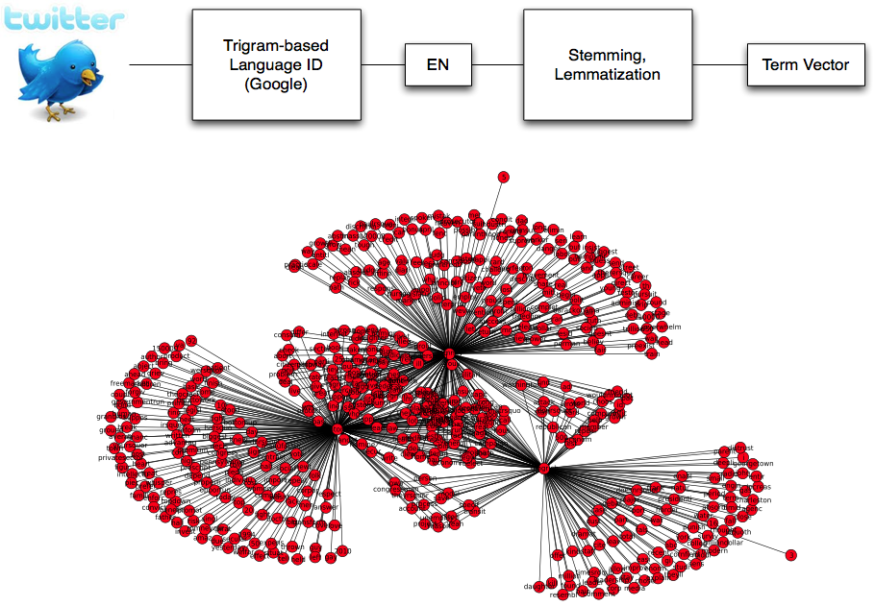
Fast Computational Linguistics

Slide 27
Text Cleaning
Tweet text is dirty
(RT, VIA, #this and @that, ROFL, etc)
Use a stoplist to produce a stripped-down tweet
import string
stoplist_str="""
a
a's
able
About
...
...
z
zero
rt
via
"""
stoplist=[w.strip() for w in stoplist_str.split('\n') if w !='']

Slide 28
Language ID
Language identification is pretty easy…
Every language has a characteristic distribution of tri-grams (3-letter sequences);
E.g. English is heavy on “the” trigram
Use open-source library “guess-language”

Slide 29
Stemming
Stemming identifies root of a word, stripping away:
Suffixes, prefixes, verb tense, etc
“stemmer”, “stemming”, “stemmed” ->> “stem”
“go”,”going”,”gone” ->> “go”

Slide 30
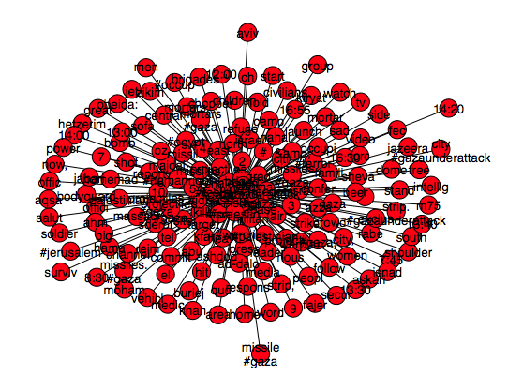
Term Networks
Output of the cleaning step is a term vector
Union of term vectors is a term network
2-mode network linking speakers with bigrams
2-mode network linking locations with bigrams
Edge weight = number of occurrences of edge bigram/location or candidate/location

Slide 31
Build a larger net
Periodically purge single co-occurrences
Edge weights are power-law distributed
Single co-occurrences account for ~ 90% of data
Periodically discount and purge old co-occurrences
Discourse changes, data should reflect it.

Slide 32
Israel vs. Hamas on Twitter

Slide 33
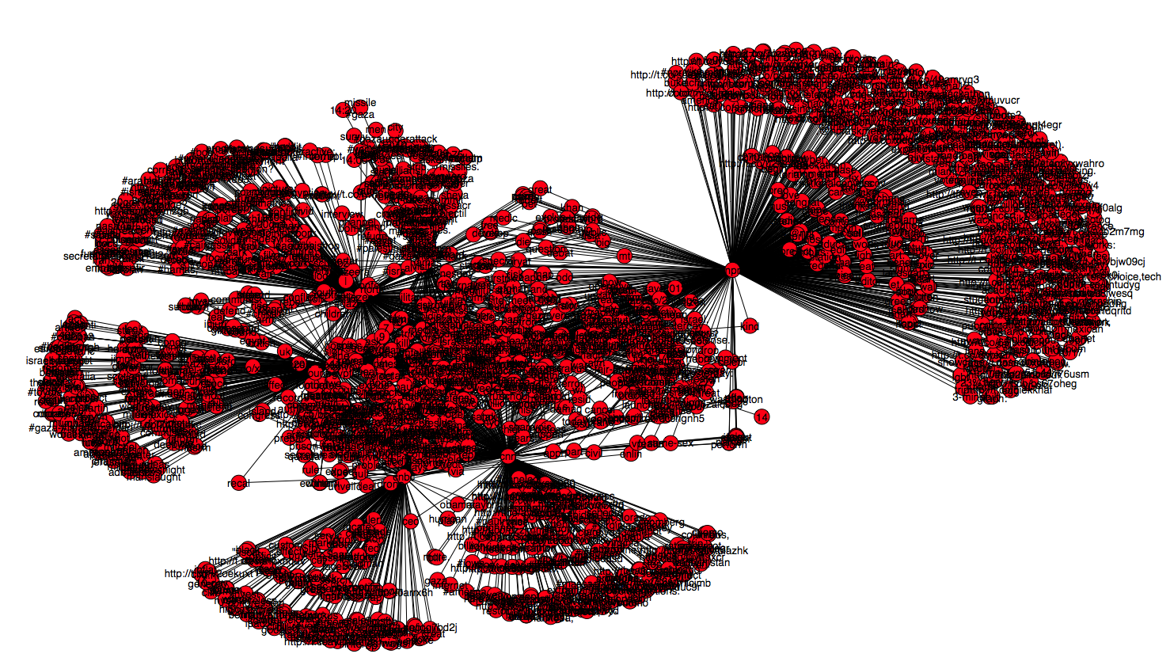
Israel, Hamas and Media

Slide 34
Metrics computation
Extract ego-networks for IDF and HAMAS
Extract ego-networks for media organizations
Compute hamming distance H(c,l)
Cardinality of an intersection set between two networks
Or… how much does CNN mirror Hamas? What about FOX?
Normalize to percentage of support

Slide 35
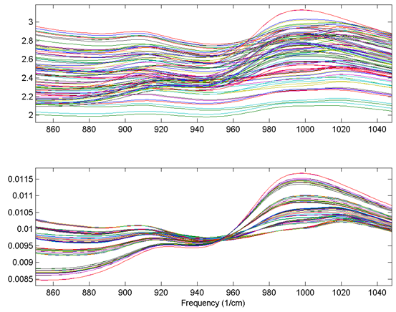
Aggregate & Normalize
Aggregate speech differences and similarities by media source
Normalize values

Slide 36
Media Sources, Hamas and IDF

Slide 37
Ron Paul, Romney, Gingrich, Santorum March 2012 (based on Twitter Support)

Slide 38
Conclusions
This works pretty well! ;-)
However – it only works in aggregates, especially on Twitter.
More text == better accuracy.

Slide 39
Conclusions
The algorithm is cheap:
O(n) for words on ingest – real-time on a stream
O(n^2) for storage (pruning helps a lot)
Storage can go to Redis
make use of built-in set operations

